Slide 1
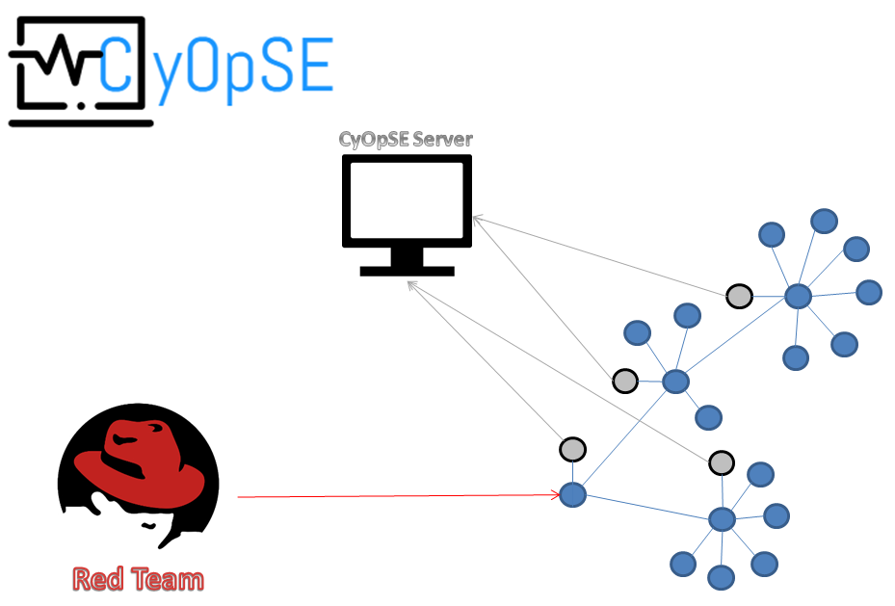
C1C Herbert, C1C Cavassa, C1C Johnston
Cyber Operations Simulation Evaluator
15APRIL2017
Overview
The Cubic Corporation has teamed up with USAFA to research a novel and effective way to perform cyber effects adjudication during large exercises.
Problem Statement
When exercising cyberspace capabilities the Air Force does not have an automated way to observe (near real time) if a player is taking actions in cyberspace and what the resultant effects are.
Initial Tasks
Creating/prototyping a capability to observe a cyber range via sensors or network capture
Defining effects and mapping capabilities to effect
Create a method to detect deployment of capabilities and resulting effect
Develop a visualization method and centralized control method
Problems
Potential packet loss from using wireless
Displaying results on website in Commander readable format
Controlling multiple nodes
Developing a controlled testing environment
Consistent attacks to measure
Results
We were able to successfully live capture network traffic, detect attacks on designated High Value Targets and send logs to a centralized server from a black box style deployable system.
What Needs to Be Done
Standard formatting
Quick Deployability
Machine Learning
Clusters
Real Time Visualization
What We Did
Created a deployable system to monitor and report network events to a centralized network
Created a website front-end to eventually display gathered information from a network of deployable systems
Developed a new system for Cyber Operation Debriefing
Attended Red Flag at Nellis AFB to observe a Cyber Operation Exercise and to research what the warfighter needs to conduct effective debriefs.

